Slide 1
Character

Slide 2
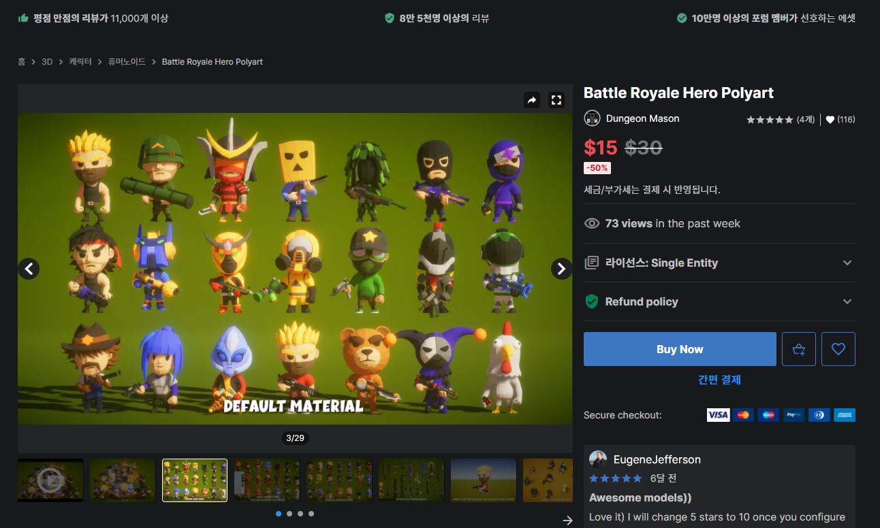
Notes:
https://assetstore.unity.com/packages/3d/characters/humanoids/battle-royale-hero-polyart-184587

Slide 3
UI

Slide 4
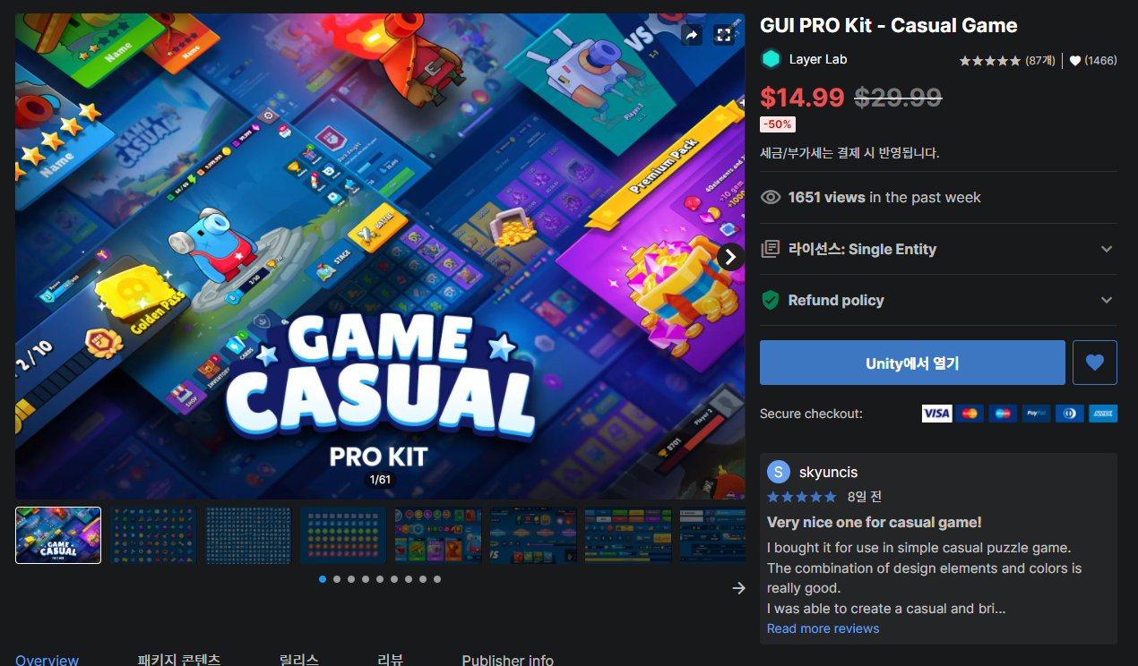
Notes:
https://assetstore.unity.com/packages/2d/gui/gui-pro-kit-casual-game-176695

Slide 5
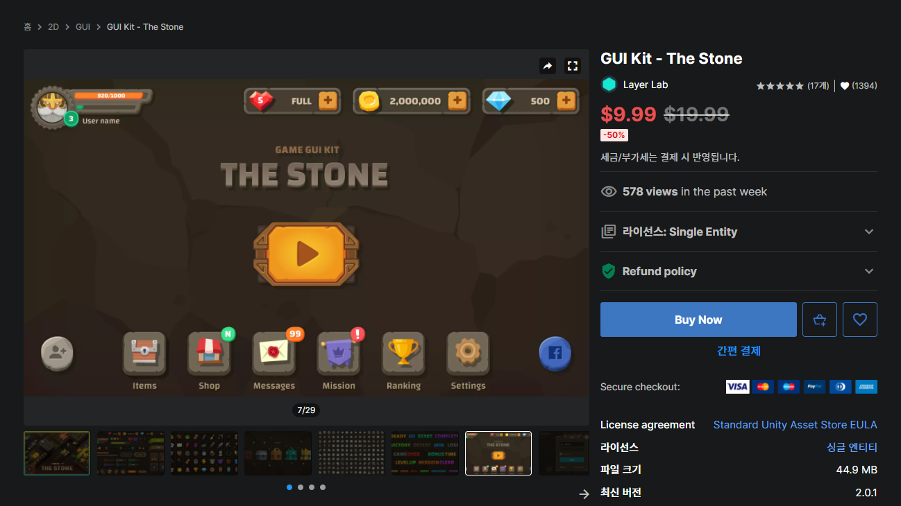
Notes:
https://assetstore.unity.com/packages/2d/gui/gui-kit-the-stone-116852

Slide 6
Map

Slide 7
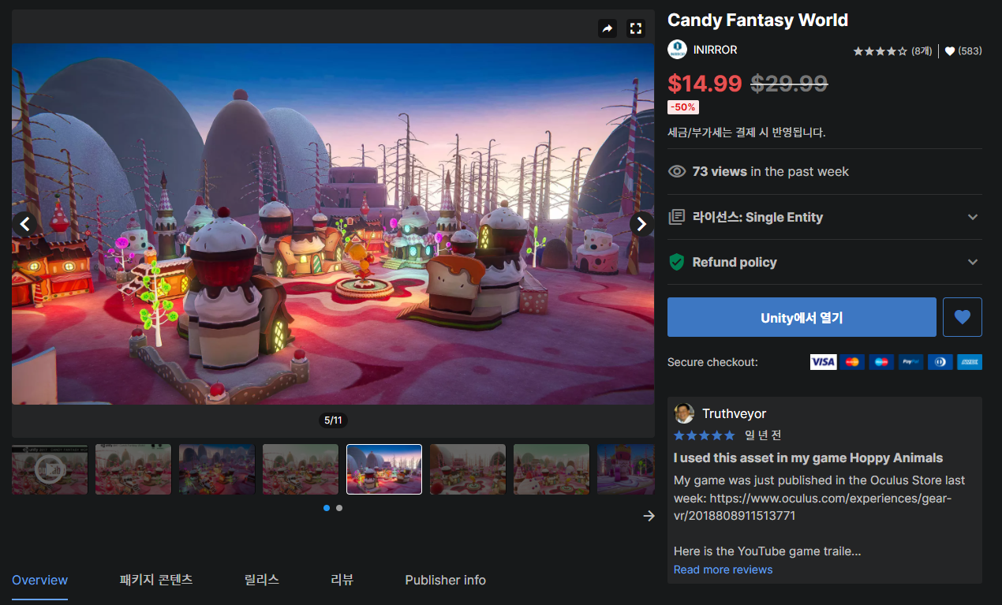
Notes:
https://assetstore.unity.com/packages/3d/environments/fantasy/candy-fantasy-world-63784

Slide 8
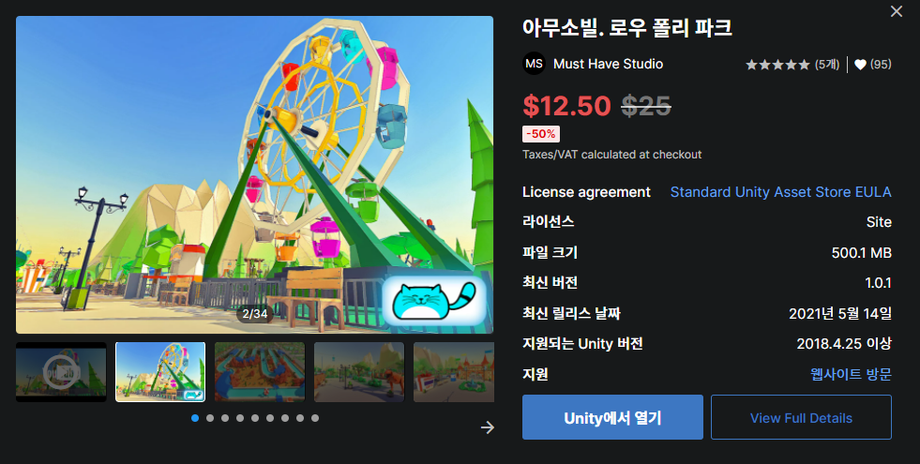
Notes:
https://assetstore.unity.com/packages/3d/environments/urban/amuseville-low-poly-park-192985

Slide 9
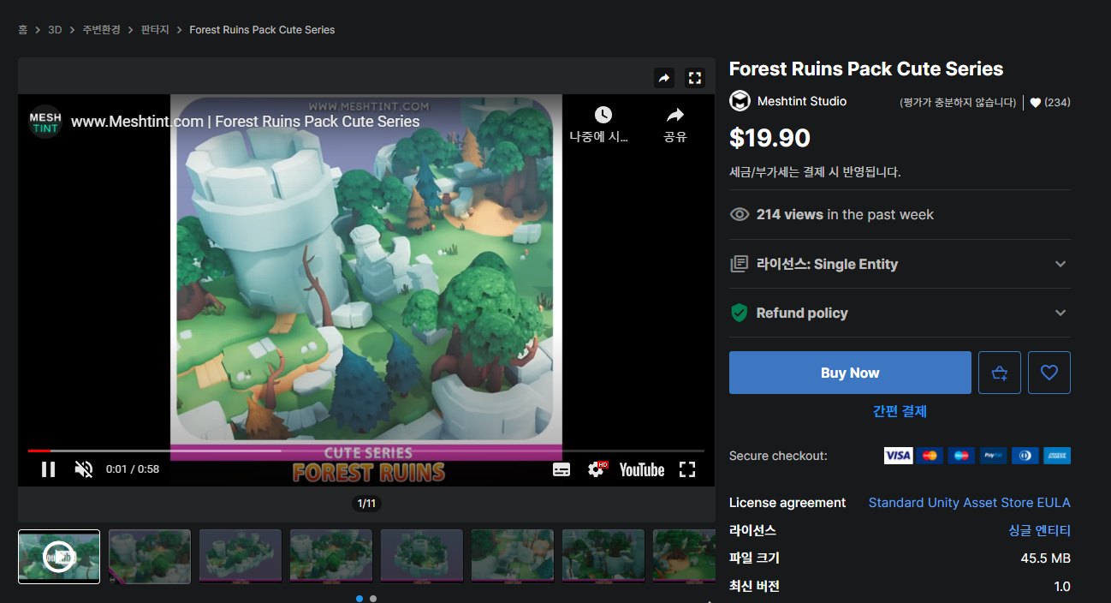
Notes:
https://assetstore.unity.com/packages/3d/environments/fantasy/forest-ruins-pack-cute-series-182412

Slide 10
Sound

Slide 11
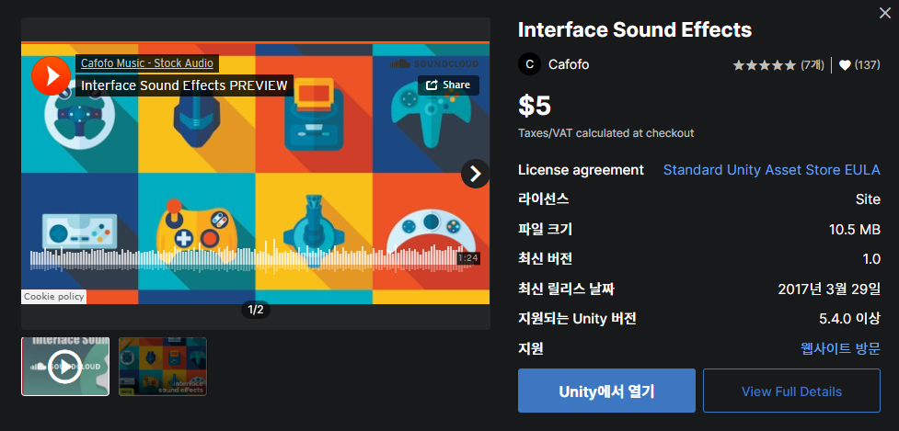
Notes:
https://assetstore.unity.com/account/assets

Slide 12
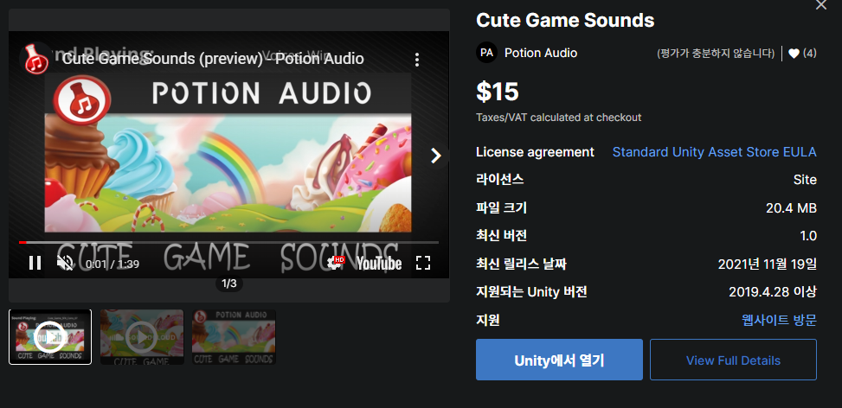
Notes:
https://assetstore.unity.com/packages/audio/sound-fx/cute-game-sounds-207544

